Slide 1

Product base Company

Slide 2
ABOUT COMPANY
Adobe Inc., formerly (1982–2018) Adobe Systems Incorporated, American developer of printing, publishing, and graphics software. Adobe was instrumental in the creation of the desktop publishing industry through the introduction of its PostScript printer language. Its headquarters are located in San Jose, California.

Slide 3
YEAR OF EXISTENCE WITH HISTORY
1982
Since 1982 Adobe has been delivering award-winning software and technologies that have redefined and advanced business and personal communications.
1984
As Adobe Systems Inc.’s first product on the market in 1984, Adobe PostScript was soon followed by Adobe’s other graphic technologies at the time, Illustrator, Photoshop and Type Manager.
2000
In January 2000 Adobe was named one of the 100 best companies to work for in America by Fortune. President and co-founder Charles Geschke announced plans to retire effective March 2000.

Slide 4
COUNTRY OF ORIGIN & COUNTRIES FOR BUSINESS
California
Mountain View, California, U.S. Adobe was founded
As of Q2 FY20, Adobe generated over $2.744 billion in revenue from the following Americas, Europe Middle East and Africa, Asia Pacific, and China regions.

Slide 5
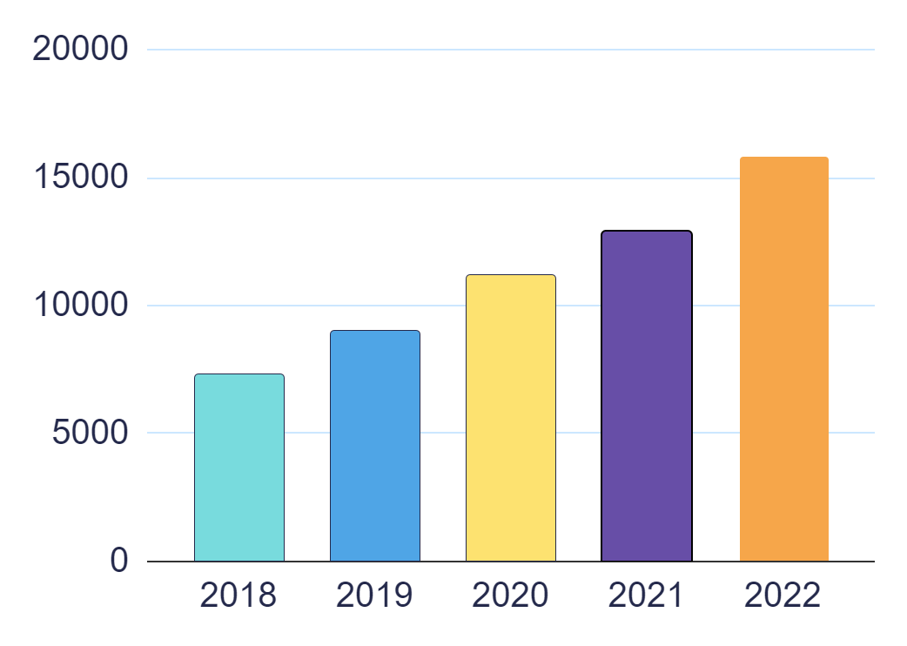
Revenue as per the NSE/ NYSE (Last 5 years)
$ 7302 M
$ 9030 M
$ 11171 M
$ 12868 M
$ 15785 M

Slide 6
LEADERSHIP HIERARCHY OF THE COMPANY
C Level
Digital Head
Marketing Team
IT
Team
Customer Service
Warehouse Team
E-Commerce Team

Slide 7
25,988
EMPLOYEE BASE

Slide 8
RANKINGS OF THE COMPANY
Best Companies to Work
Best Technology Companies
Best Fortune 500 Companies
94th In America
12th In California
1st In San Jose, CA
1st In America
1st In California
1st In San Jose, CA
12th In America
2nd In California
1st In San Jose, CA

Slide 9
TECHNOLOGIES USED IN THE COMPANY
Adobe Real-Time CDP Is Now Working With Target
Adobe Sensei Will be Integrated with Adobe Commerce
Integrating Adobe into the Metaverse
Adobe Experience Manager (AEM) Is Integrating with Workfront and Creative Cloud

Slide 10






MAJOR PRODUCTS OF THE COMPANY WITH CLIENTS
Creative Cloud All Apps
Acrobat Pro
Photoshop
Premiere Pro
Illustrator
After Effects

Slide 11
OPERATIONAL VERTICALS OF THE COMPANY WITH CLIENTS
Industry analysts have named Adobe a leader in 40+ categories such as digital experience platforms, content management systems, customer analytics, CRM lead management, digital commerce, enterprise marketing software suites, and more.
Adobe Experience Cloud is supported by an expansive global ecosystem of 4,000+ active solution integrators, agencies, technology, and marketplace partners and more than 460,000 developers and community members.

Slide 12
ROLES I HAVE INTERESTED
SOFTWARE ENGINEERING
Join our team to help us tackle problems of scale as you work on cutting-edge, open-source technologies and create meaningful solutions for our customers' needs.
CLOUD PLATFORM ENGINEERING
Our core cloud technologies are foundational to the Adobe cloud services used by millions around the world. Come put your stamp on the Adobe Multi-Cloud Foundation, built on Ethos and Managed Data Services.

Slide 13
Data Operations Director
PACKAGES OFFERED BY COMPANY FOR ROLE(S)
User Experience Designer
$191,661
$117,807
Senior Designer
Business Intelligence Analyst
$130,038
$116,926
Software Development Engineer
Sales Professional
$116,310
$124,745

Slide 14
VISITS COMPANY GAVE TO LPU CAMPUS
Adobe doesn't visit our university yet, but they could visit us soon! We have great students with us that I think they'll love our Transformers.

Slide 15
PROS AND CONS
PROS AND CONS
PROS
CONS
Education fund – In case you’re planning for higher education, you can opt for this program and Adobe would fund up to 10,000 USD.
Good work environment with amazing social internal groups for different interests & causes
Most Adobe Products are free while a few software rates are discounted.
Lack of progression opportunities
Variability among teams, advancement
Changing the job role is very tuff
it is a large company so sometimes not super agile
The con in there is that there is little room for career growth/promotion

Slide 16
RESOURCES
Websites
www.adobe.com
www.glassdoor.co.in
www.zippia.com
www.groww.in
www.crunchbase.com
www.quora.com
www.hoodoo.digita
www.lpu.in

Slide 17
THANKS!

Slide 18

Service base Company

Slide 19
ABOUT COMPANY
TCS’s lead initiative aims to create an inclusive and equitable culture, where each individual feels seen and heard, and their contributions respected and valued. TCS believes that each person has the ability to contribute to building greater futures for our teams, clients, and societies. Through this initiative, we recognize the power of diverse perspectives in fueling inclusive and sustainable growth and creating shared value.

Slide 20
YEAR OF EXISTENCE WITH HISTORY
1968
Tata Consultancy Services launched as a division of Tata Sons on April 1, 1968, as a management and technology consultancy that would create demand for downstream computer services.
1976
Crossed the $1 Million mark in export revenues, winning us the top exporter award from the Engineering Export Promotion Council in 1976-77.
1997
Participated significantly in the Y2K remediation opportunity, by pioneering the concept of a software factory. Used a highly automated approach by leveraging special tools developed for Y2K conversion, to minimize human intervention, and remediated about 700 million lines of code.

Slide 21
COUNTRY OF ORIGIN & COUNTRIES FOR BUSINESS
TCS has operations in the following locations:
India:
Asia (excluding India):
Oceania:
Africa:
Europe:
North America:
South America:
TCS has grown enormously over the last decade to become the second-largest company in India in terms of market capitalization. The largest portion of their revenue comes from software development and maintenance, followed by IT enterprise consulting. Almost half of their revenue is generated from the banking, financial services, and insurance sector.
India
Mumbai, Maharashtra, India. TCS was founded

Slide 22
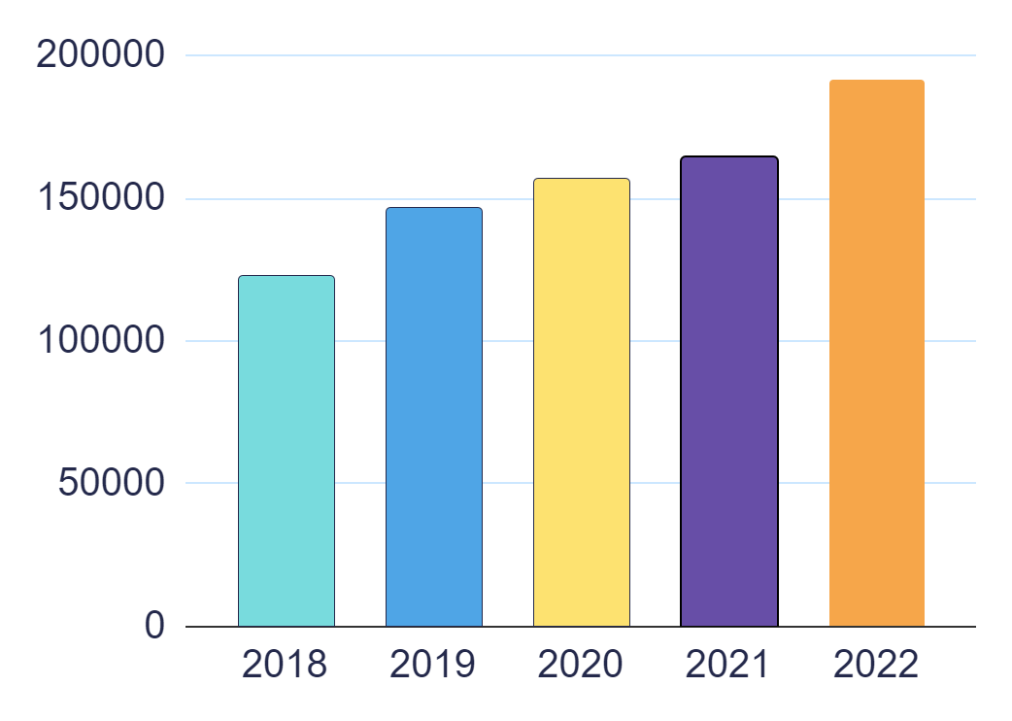
Revenue as per the NSE/ NYSE (Last 5 years)
1,23,104 Cr.
1,46,463 Cr.
1,56,949 Cr.
1,64,177 Cr.
1,91,754 Cr.

Slide 23
LEADERSHIP HIERARCHY OF THE COMPANY
CEO
Corporate Head(Global Affairs)
Regional Heads
CTO
CFO
COO
Regional Heads

Slide 24
616,171
Represent 157 nationalities across 55 countries
EMPLOYEE BASE

Slide 25



RANKINGS OF THE COMPANY
TCS Wins IoT Breakthrough Award for its Intelligent Urban Exchange Software January 12, 2021
TCS Wins Award for AI Software that Helps Firms Protect Returning Workers During COVID-19
TCS Wins 2021 CIO 100 Award for Workplace Resilience Solution Developed During Pandemic

Slide 26


TECHNOLOGIES USED IN THE COMPANY
A Machine First™ Approach to Harness Abundance for the Intelligent Enterprise
Harvest intelligence by maximizing AI throughout your enterprise using MFDMTM
TCS Engineering Services for the Internet of Things empowers companies to design and deploy IoT solutions
Apply Deep Learning to Improve and Accelerate Sentiment Analysis and Opinion Mining

Slide 27






MAJOR SERVICES OF THE COMPANY WITH CLIENTS
Account-Based Marketing
Content Marketing
Conversion Rate Optimization
Customer Data Platform
Digital Analytics
Email Marketing

Slide 28
OPERATIONAL VERTICALS OF THE COMPANY WITH CLIENTS
They will have domain expertise, consulting, vertical know-how, HR, finance, and marketing expertise,” the person added.
These solutions create immense value for our customers by helping them embrace new business models, pursue new revenue streams, deliver superior customer experiences or build resilience and efficiency into their operations, and gain competitive differentiation.

Slide 29
ROLES I HAVE INTERESTED
SOFTWARE ENGINEERING
A key member of the team, you will produce, install and implement new and modified computer systems, networks, and related operating software. You will carry out enhancements to existing applications as well as develop and implement new applications for a variety of clients across a range of industries.
NETWORK ENGINEER
You will be involved in the full network solution life-cycle; this includes design, installation, and implementation project work. Network Engineers may work internally as part of the organization’s IT support team or an outsourced IT networking consultancy firm working with a number of clients. Other tasks include monitoring network performance, and troubleshooting network problems and outages.

Slide 30
Associate Consultant
PACKAGES OFFERED BY COMPANY FOR ROLE(S)
Developer
₹ 10,28,759
₹ 5,15,371
System Engineer
Team Leader
₹ 4,30,331
₹ 7,17,127
Software Engineer
Senior Business Analyst
₹ 3,72,758
₹ 7,34,114

Slide 31
VISITS COMPANY GAVE TO LPU CAMPUS
Yes TCS visits our campus and they give good placements to our students, LPU's success in the placement process can be attributed to its rigorous curriculum, commitment to employability skills, and emphasis on creating a diverse and inclusive environment for students.

Slide 32
PROS AND CONS
PROS AND CONS
PROS
CONS
The ILP is a good place to learn and explore a new corporate environment.
You will get to interact with a lot of people from a lot of different places and you will get to live in a different part of the country which will be beneficial for our growth.
The ILP is the best place for especially people from non-Computer Science backgrounds to upgrade their skill set.
HR executives act like Gods and try to intimidate new hires with unnecessary restrictions and threats.
Too much importance is given to your end rating and tests instead of focusing on learning.
Curriculum of various technologies is old and the Technical Leads are not serious about their role mainly.

Slide 33
RESOURCES
Websites
www.tcs.com
www.glassdoor.co.in
www.zippia.com
www.groww.in
www.crunchbase.com
www.quora.com
www.hoodoo.digita
www.lpu.in

Slide 34
THANKS!

